Slide 1
Title: A Survey of Model-Centric FML Systems
Papers to review:
Model fusion (Bryan Low)
Model Fusion for Personalized Learning, Thanh Chi Lam, Nghia Hoang, Bryan Kian Hsiang Low, Patrick Jaillet Proceedings of the 38th International Conference on Machine Learning, PMLR 139:5948-5958, 2021.
White-box, Black-box
Focus: learning, influence attacks etc.
??? Assume: Model are fixed and given to the server; no supervised learning by server
Single shot FML (Qinbin, zhaomin, etc)
Parties: use local data -> models (very complex models; server supervised training) -> FML
Ensemble (Liu Ling@Gatech)
Model query/processing
Pretrained based FML
Model based contractive learning
Model based protection
…

Slide 2
Definition: model, ensemble, representation.
Taxonomy:
Horizontal, vertical, hybrid, etc.
Challenges and opportunities:
The current def: on-demand training on local data
Model market
V0: each party submits its models (without the knowledge of downstream tasks from the server)
V1: single shot training. each party submits its models (with the knowledge of downstream tasks from the server)
The server gives parties sensitive or non-sensitive info
V2: proactive, the server can iteratively request the model training from the local data from each party.=> FedAvg

Slide 3
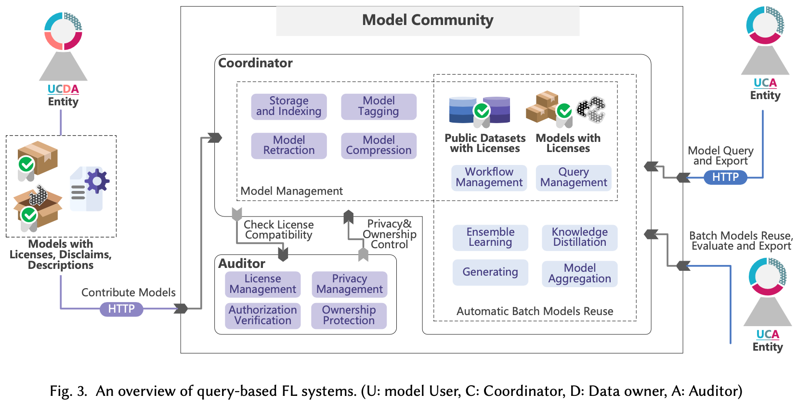
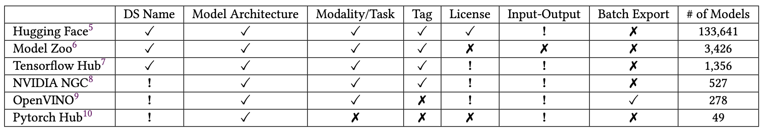

Slide 4
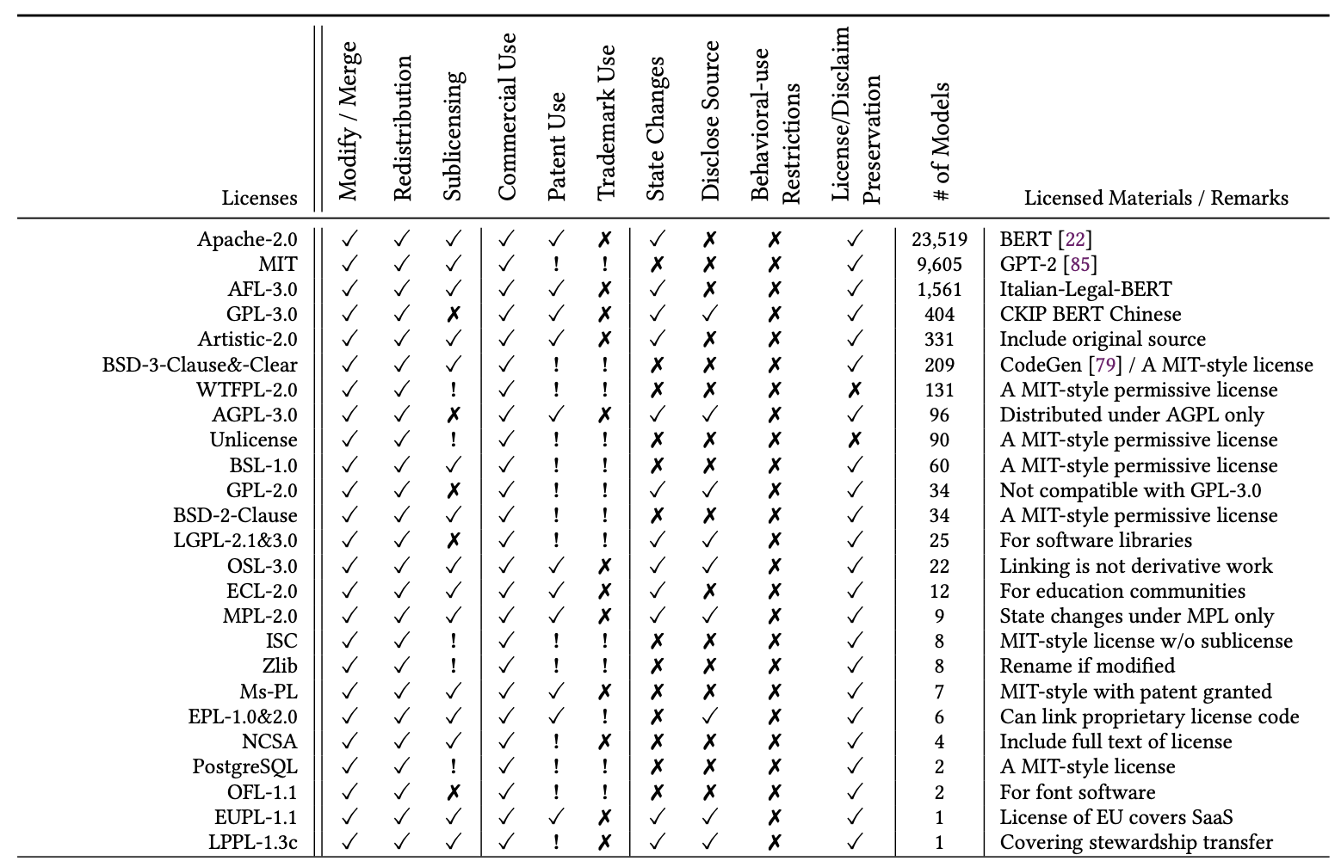

Slide 5
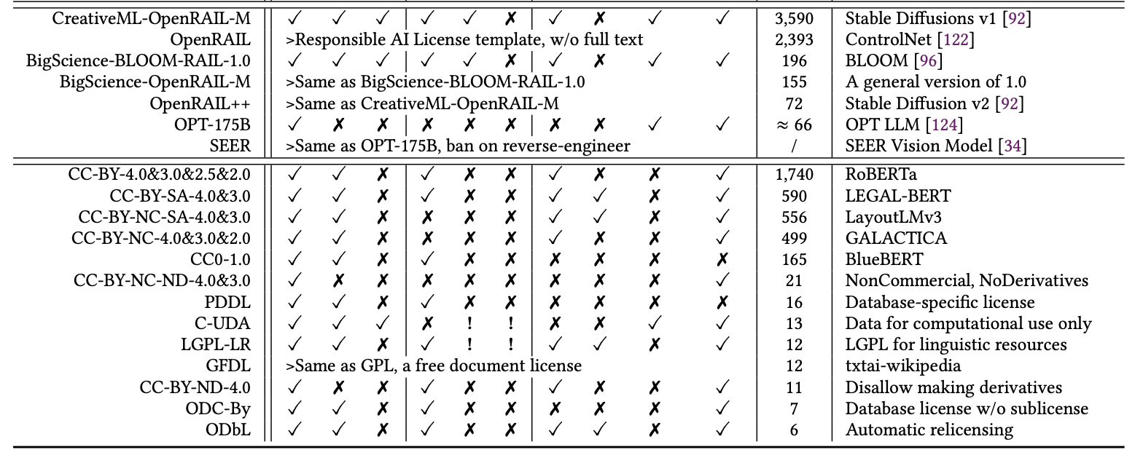
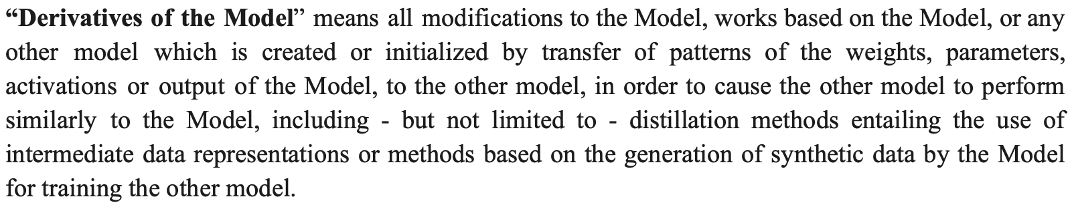

Slide 6
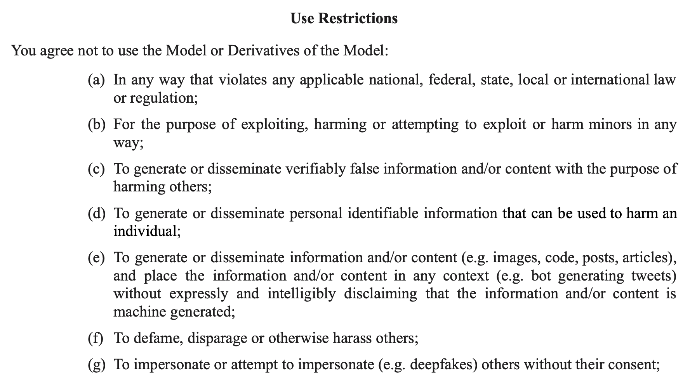
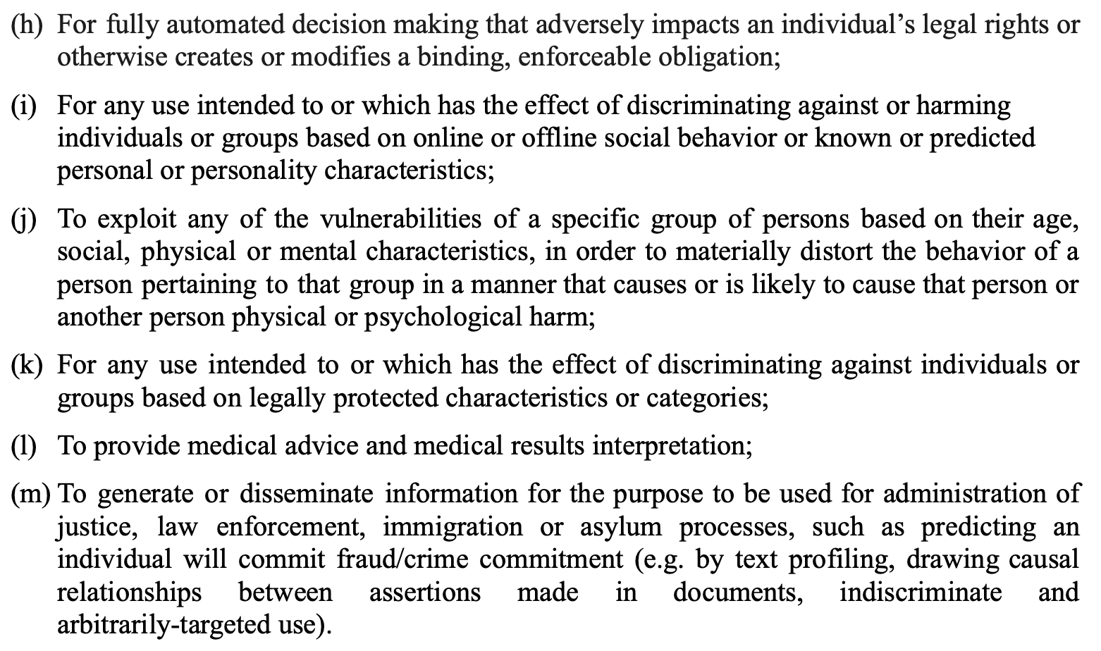

Slide 7
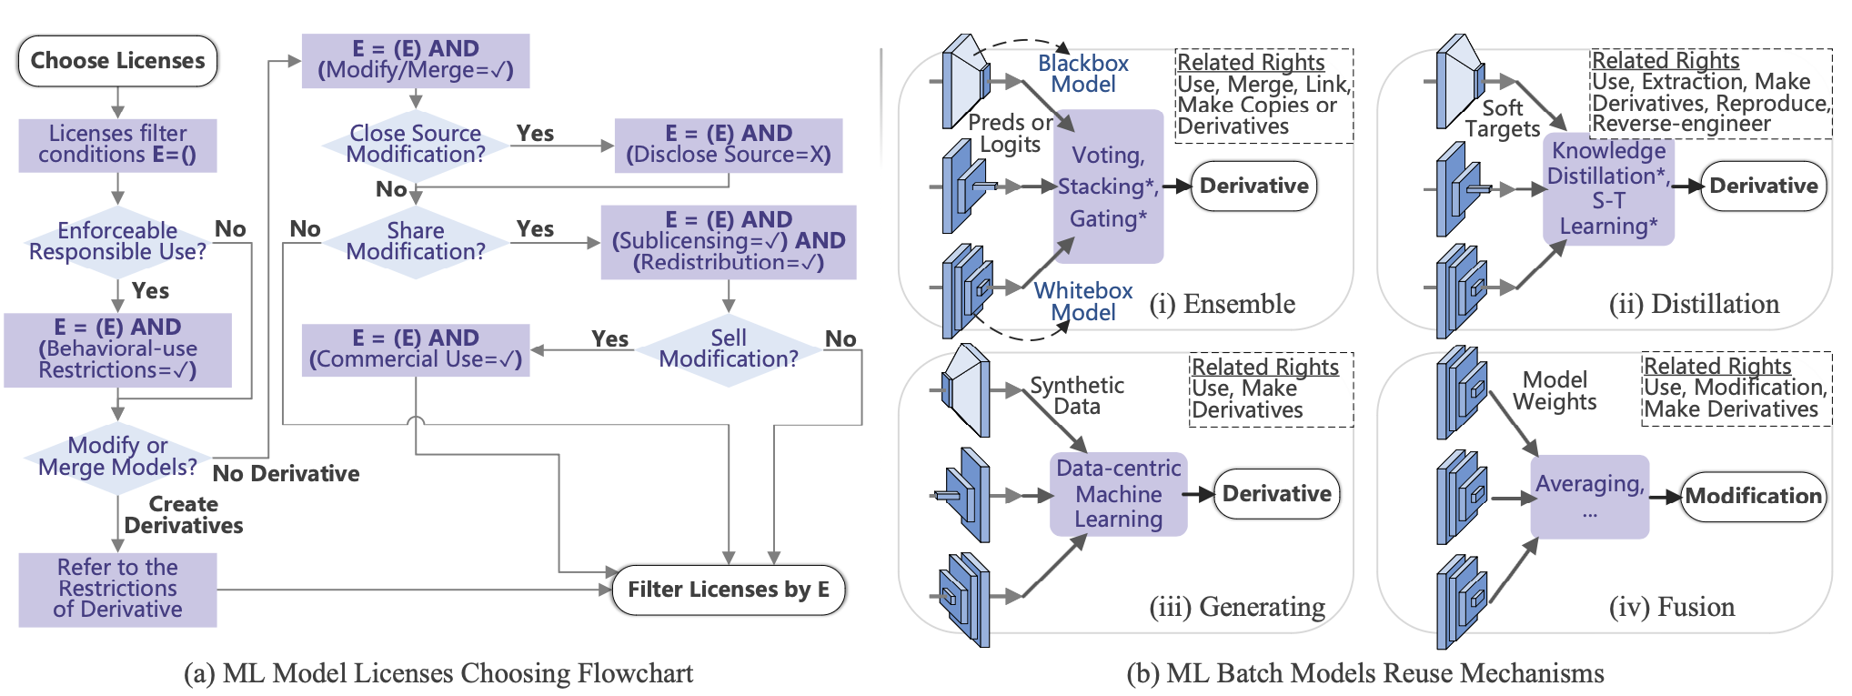

Slide 8
Preferences for Datasets or Databases: CC0-1.0, ODC-By > CC BY > C-UDA > LGPL-LR.
Preferences for Software: Apache-2.0, AFL-3.0, Artistic-2.0, ECL-2.0 > MIT, BSD-3-Clause&-Clear, BSL-1.0, BSD-2-Clause, NCSA ≈ Ms-PL > WTFPL-2.0, Unlicense, ISC, Zlib, PostgreSQL.
Preferences for Models: Apache-2.0, AFL-3.0, Artistic-2.0, ECL-2.0 > OpenRAIL and its derivatives
CreativeML OpenRAIL-M:
Therefore You cannot use the Model and the Derivatives of the Model for the specified restricted uses ... You shall require all of Your users who use the Model or a Derivative of the Model to comply with the terms of this paragraph.
You shall undertake reasonable efforts to use the latest version of the Model

Slide 9
Copyrightable 🤔
Level of creativity and originality.
Presence of at least minimal human creative effort at the time the work is produced.
Authorship -> Original intellectual conceptions.
Stable Diffusion License:
Licensor claims no rights in the Output You generate using the Model.
OpenAI Sharing&Publication Policy:
The published content is attributed to your name or company.

Slide 10
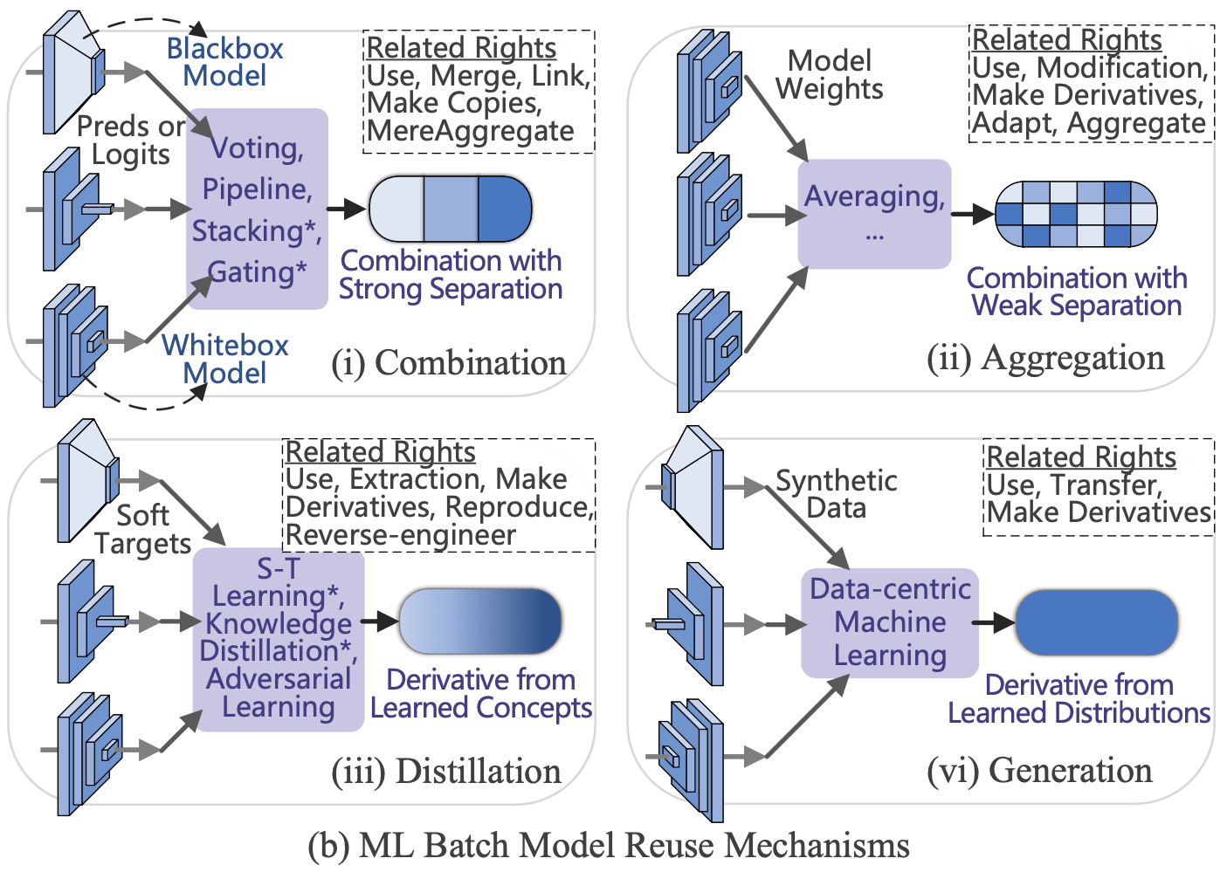
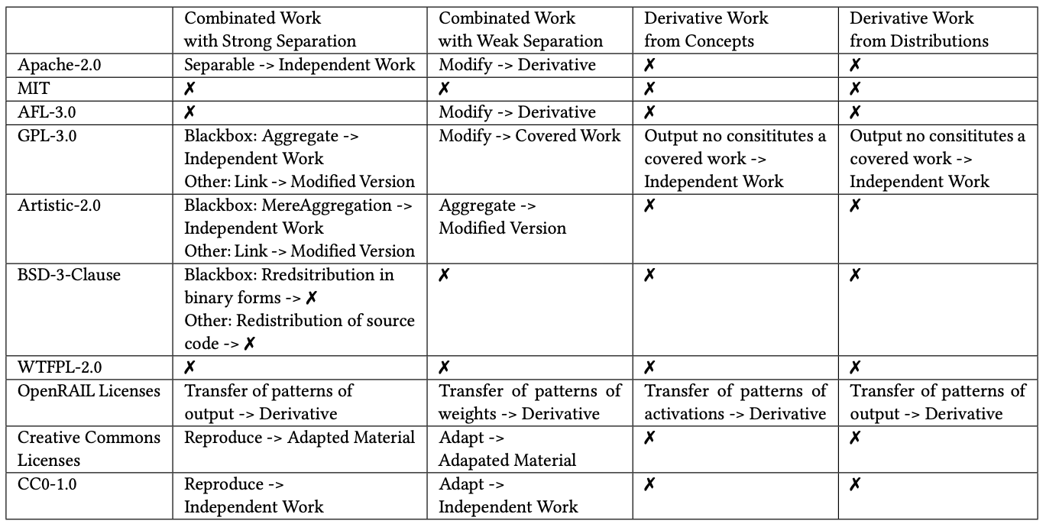

Slide 11
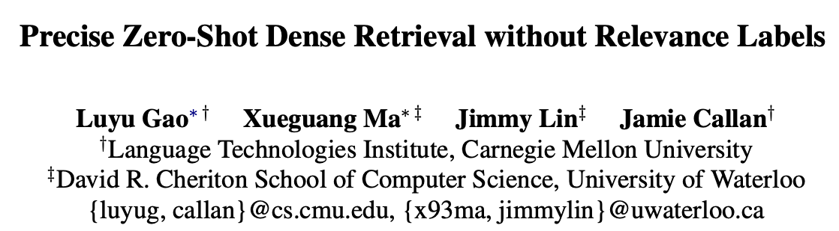
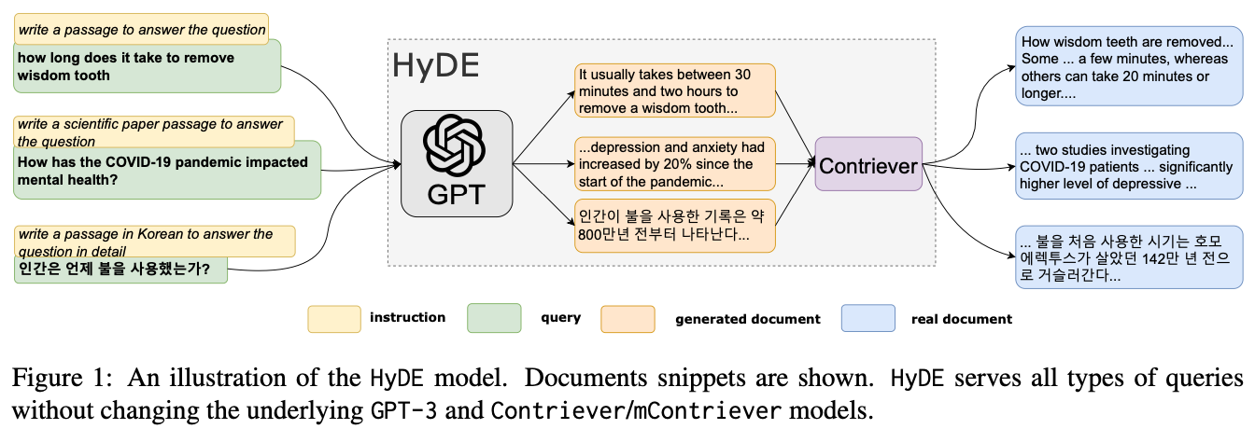

Slide 12
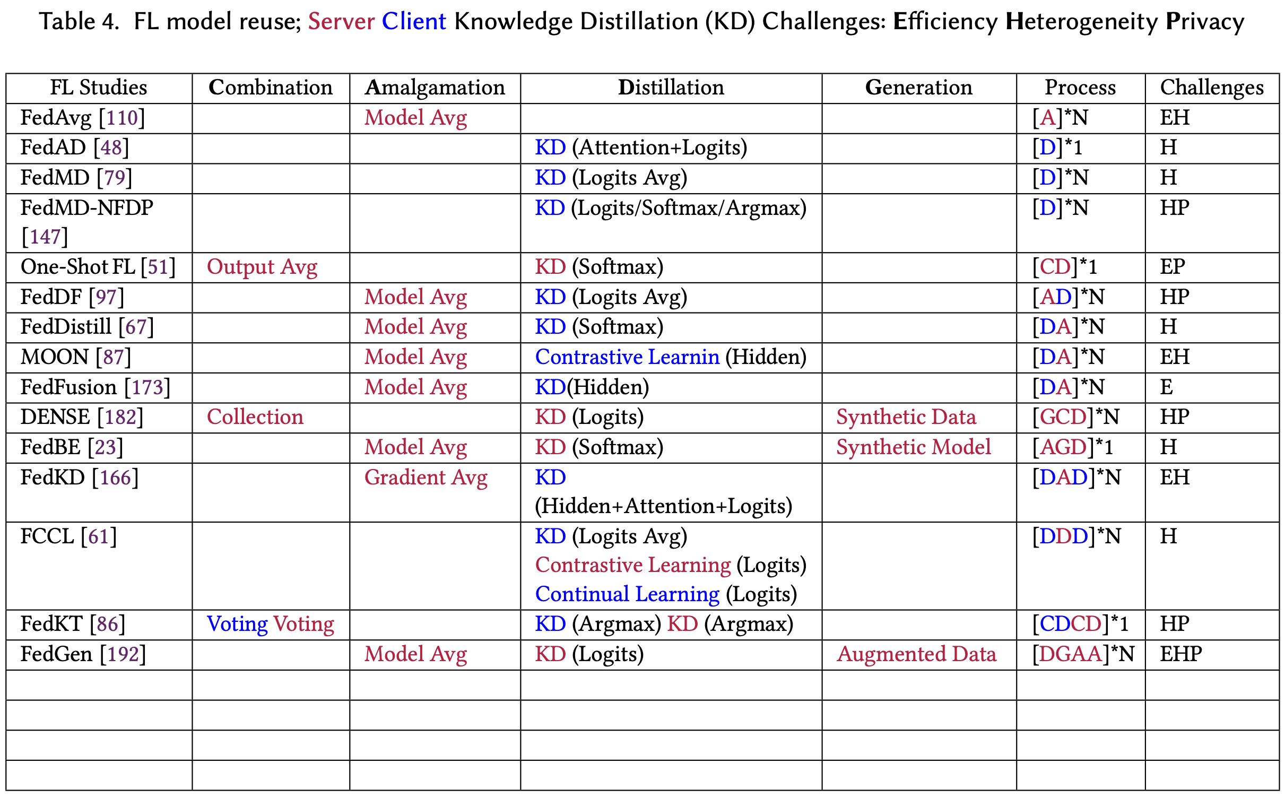

Slide 13
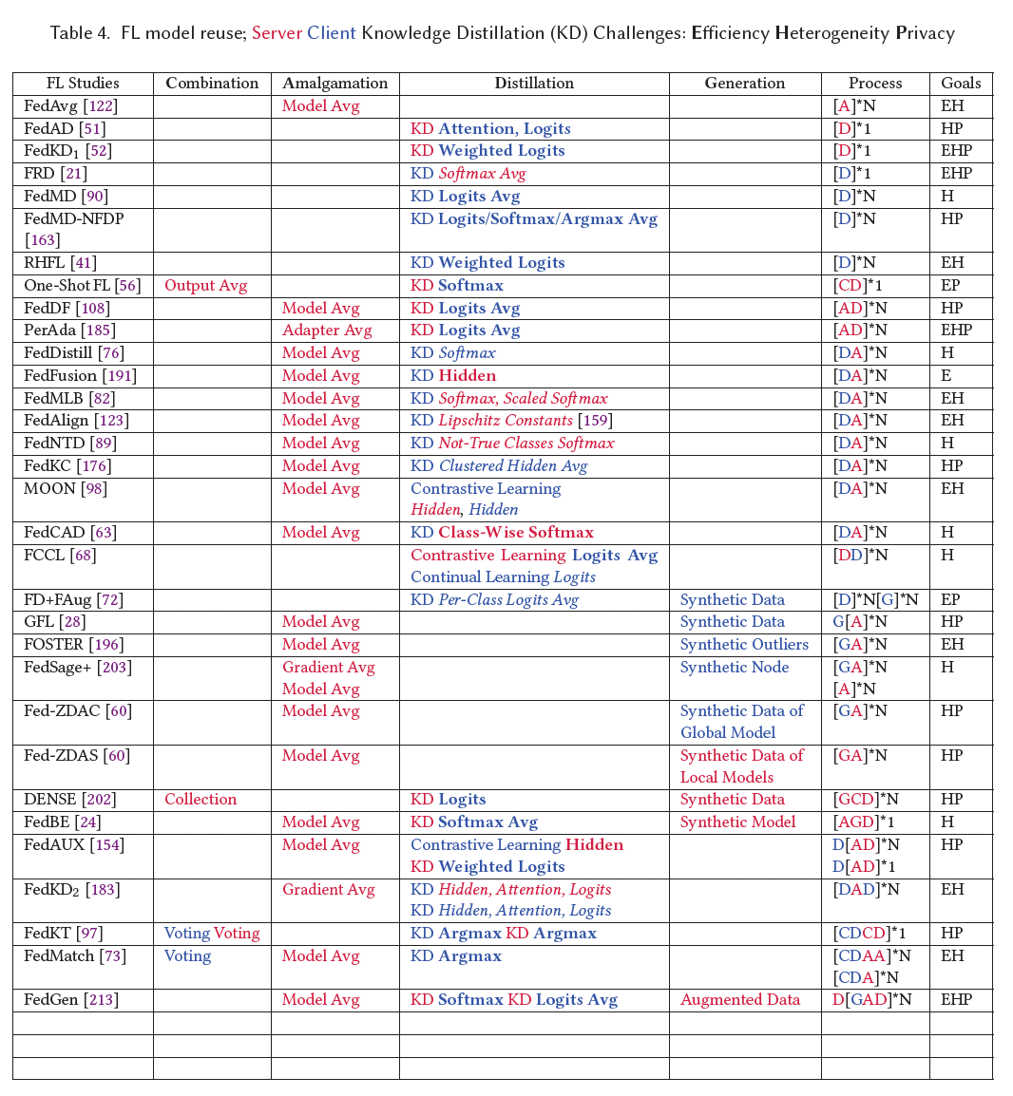

Slide 14
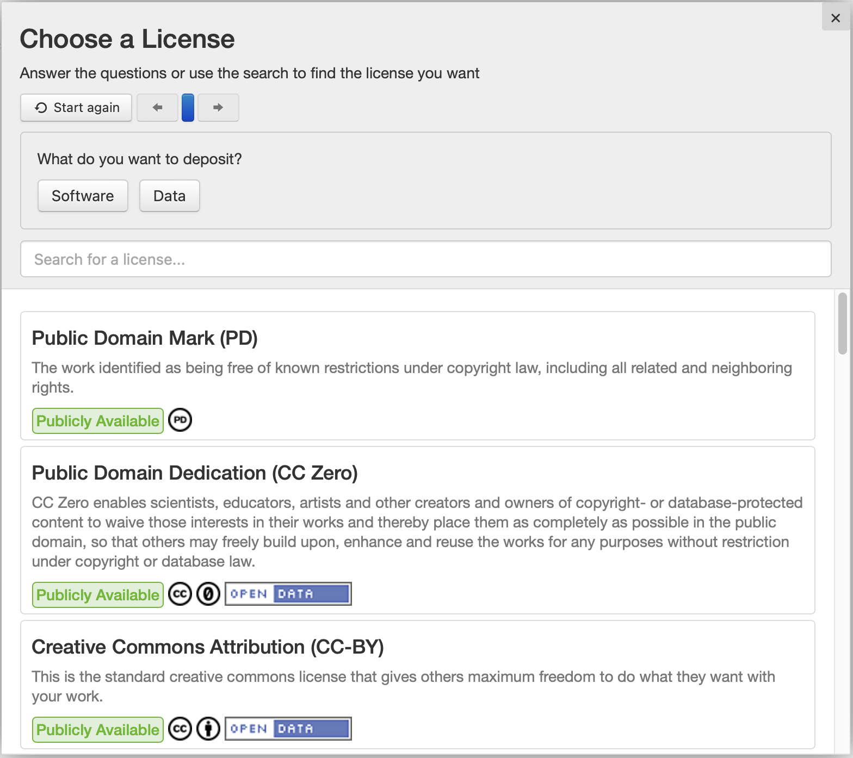
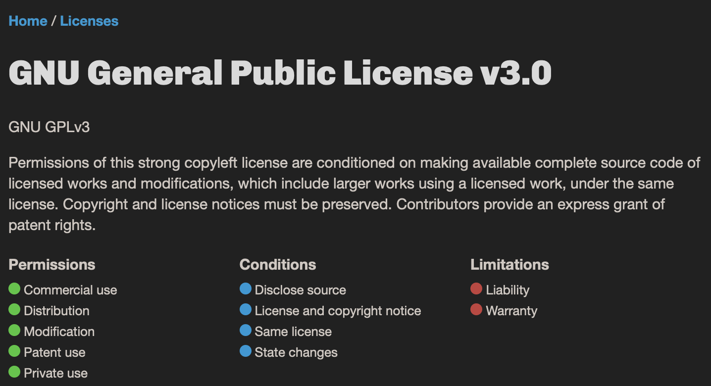
Public License Selector
Choose A License

Slide 15
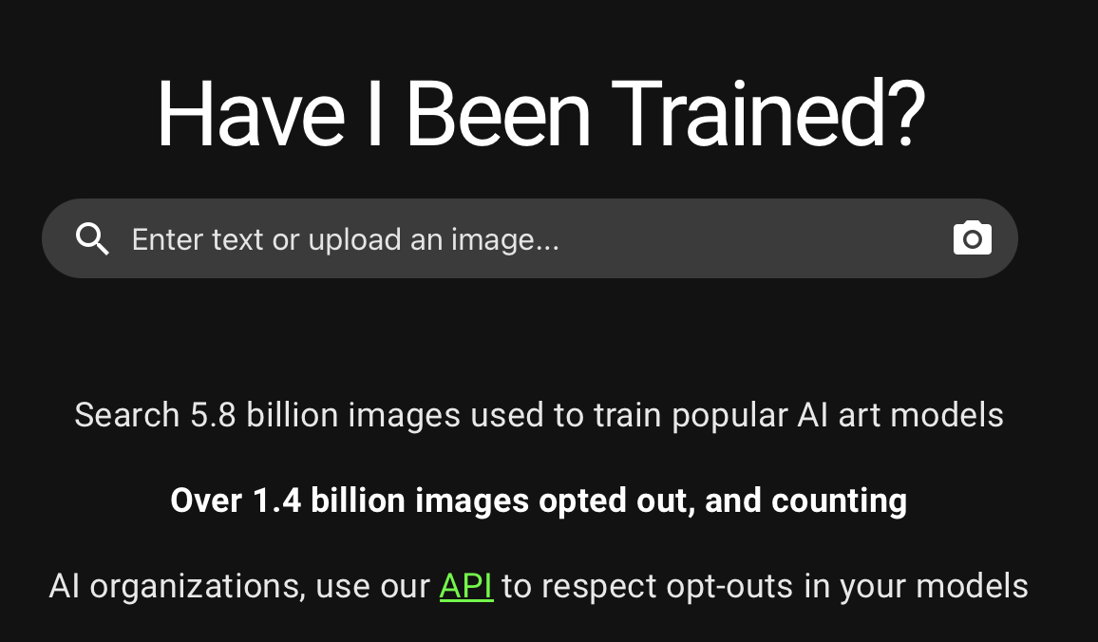
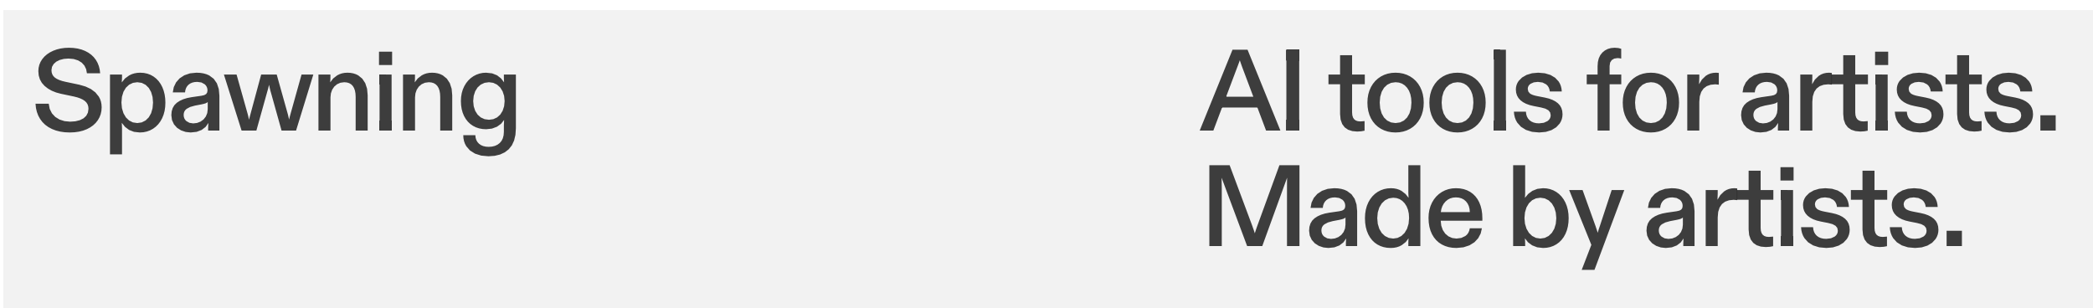
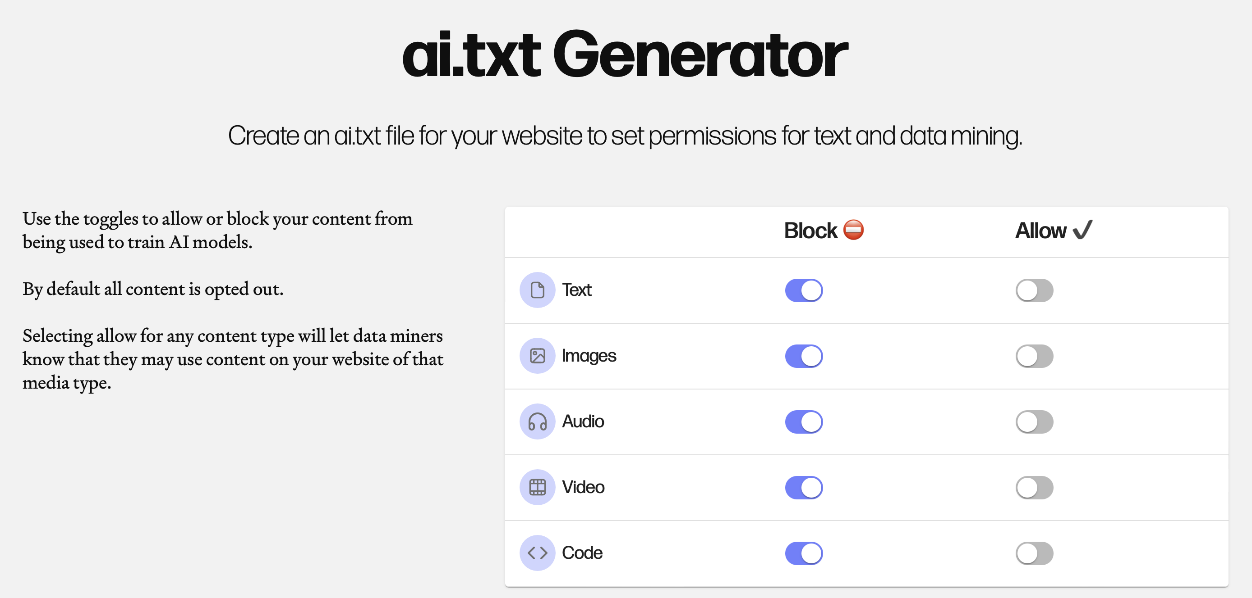
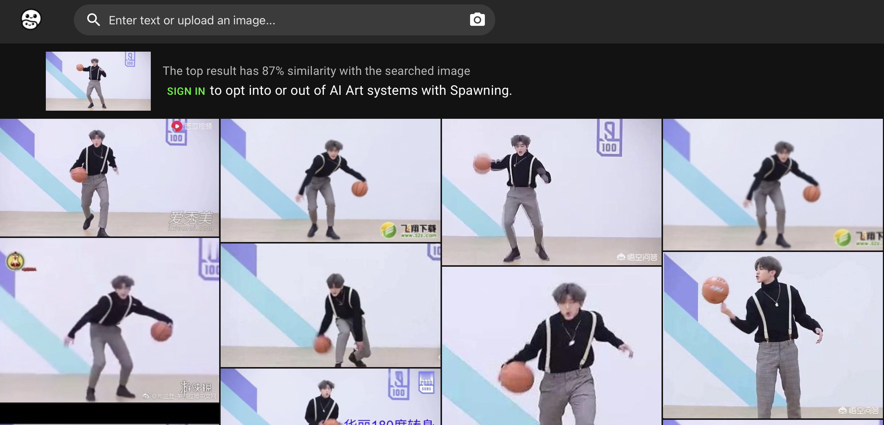
Have I Been Trained (Laion-5B)
Spawning.AI

Slide 16
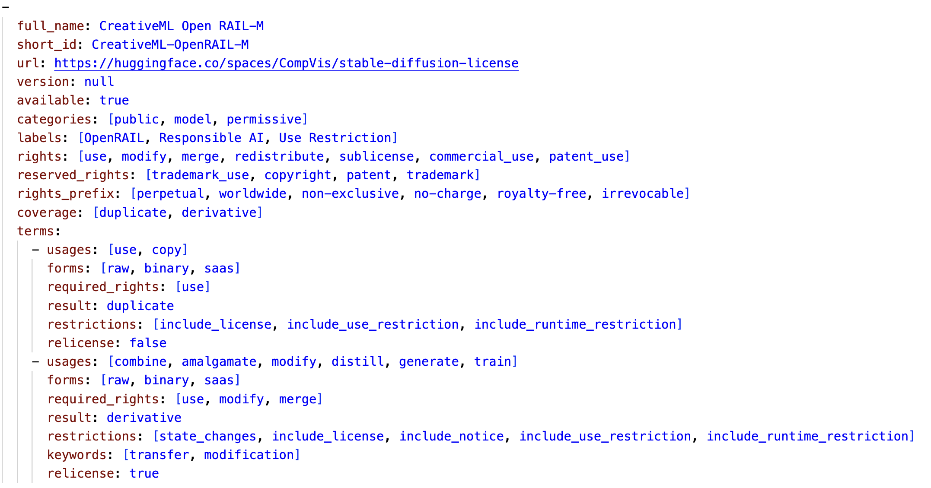
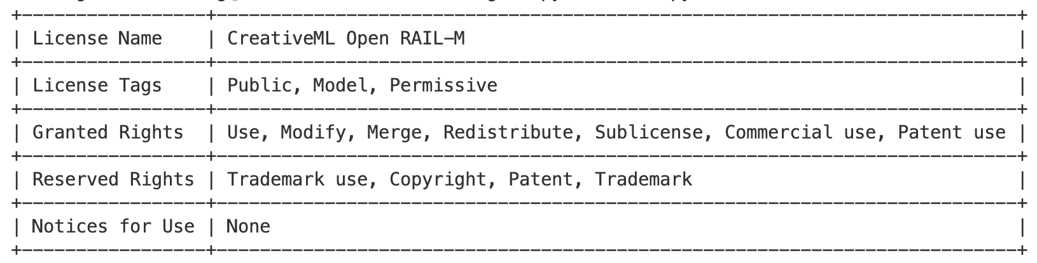
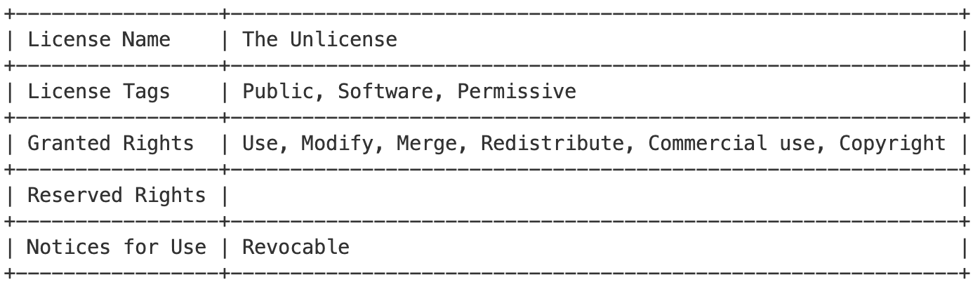

Slide 17
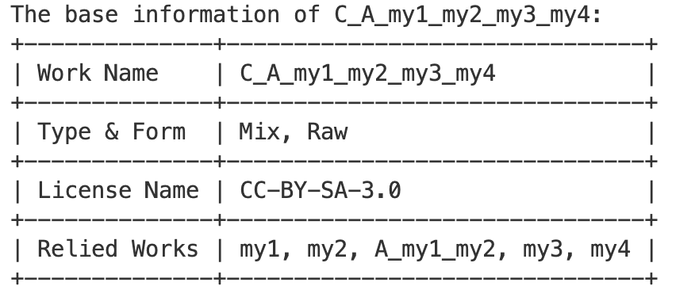
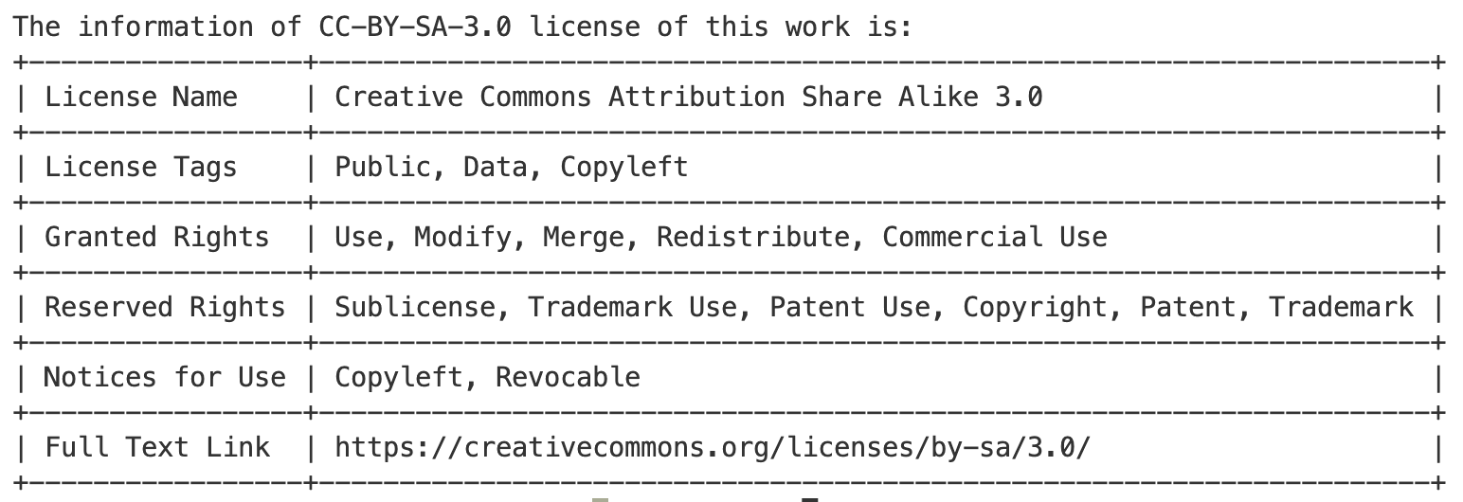
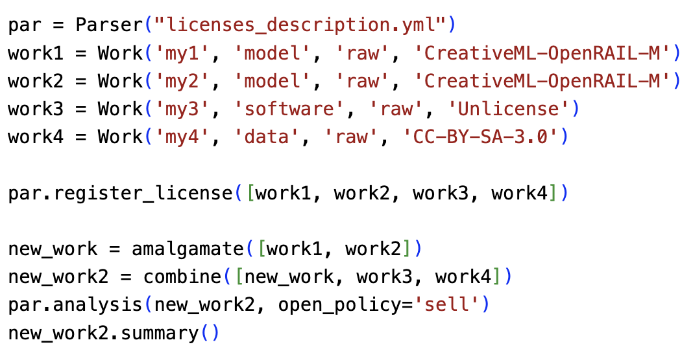
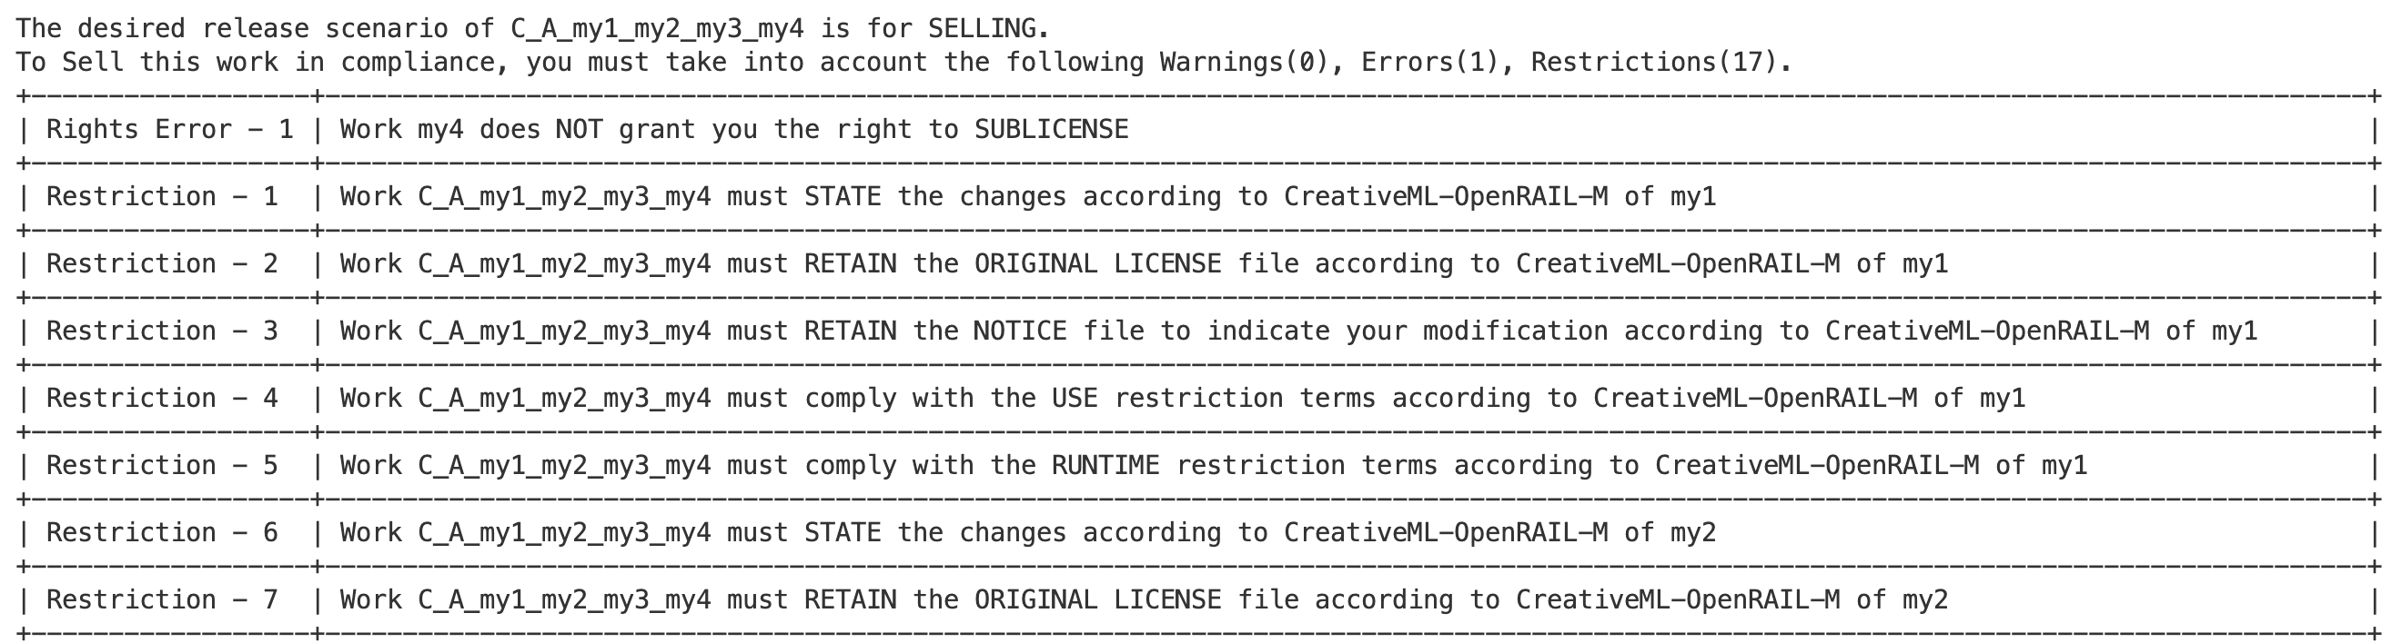
Work Information:
USE
AVG
COPY
Work
License?
USE
AVG
USE
License Information:
Work
Work
Work
Work
Work
Work
Mixworks
Subworks
Auxworks
COPY
License
License
License
Conflicts and Restrictions:

Slide 18
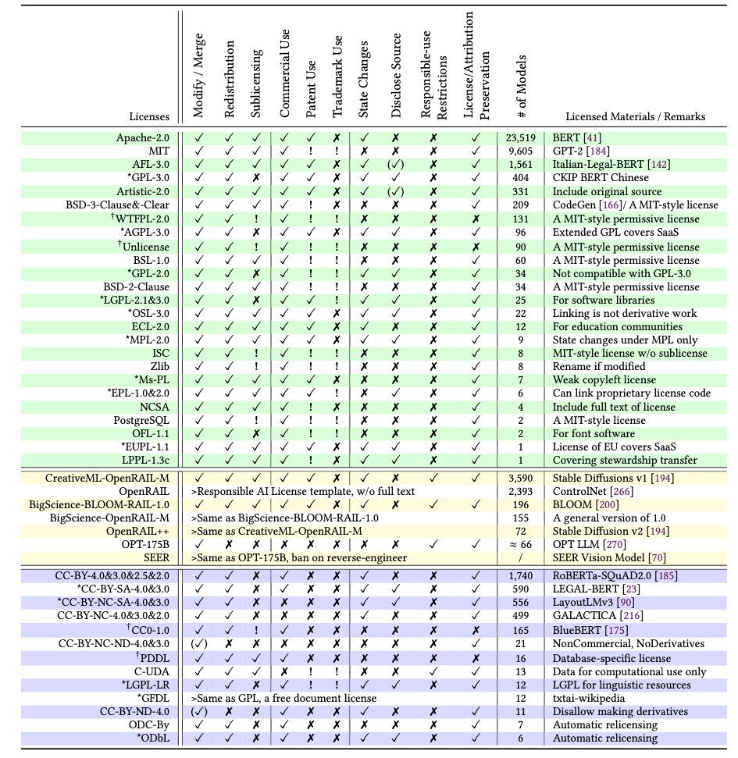
License Conflict Types:
Work
License
Rights Granting, Releasing Policy
Work
Work
Mixworks
Licenses
Multiple Copyleft Licenses
Copyleft
Copyleft
Software, Model, Data

Slide 19
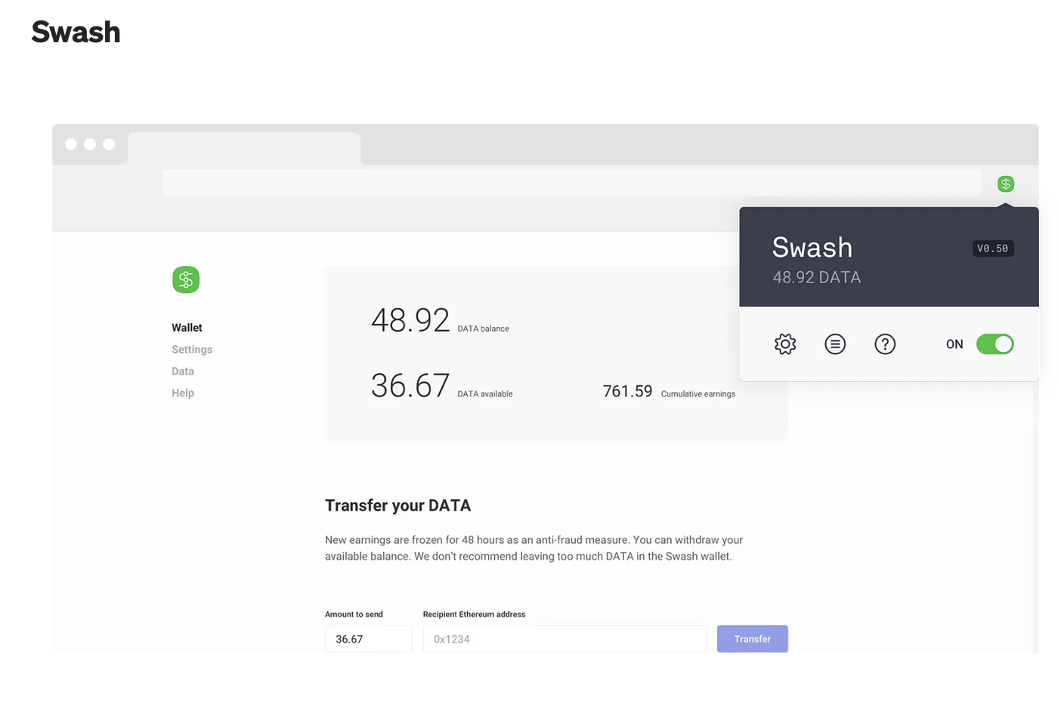
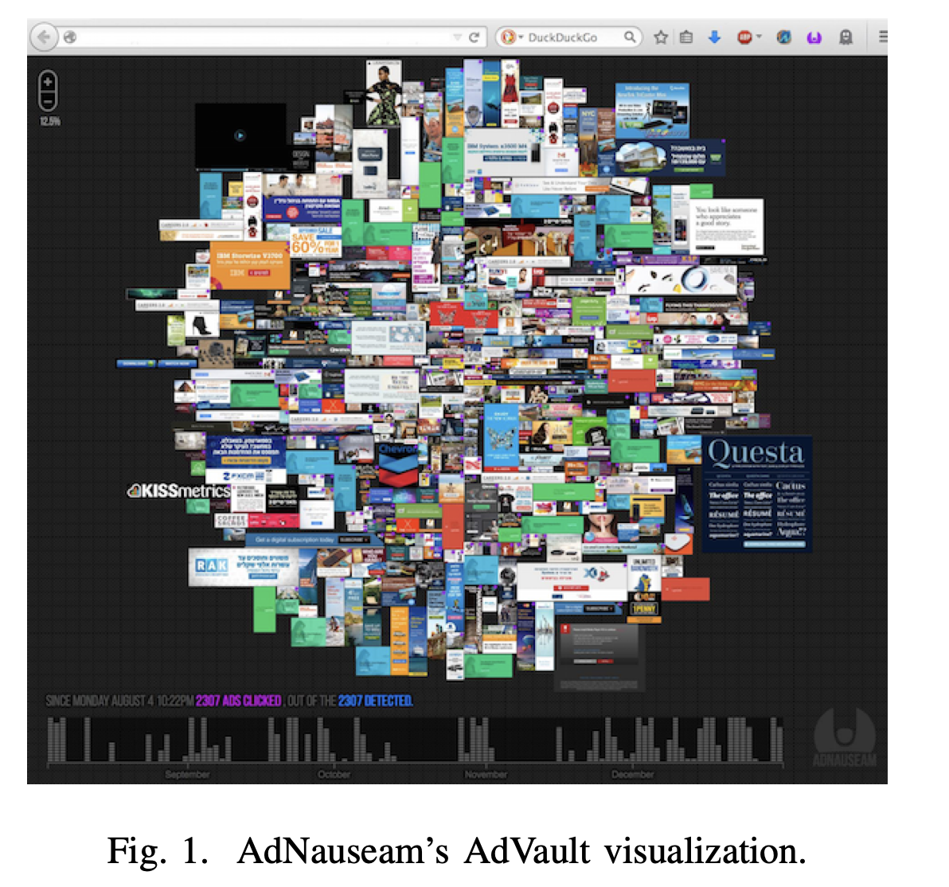
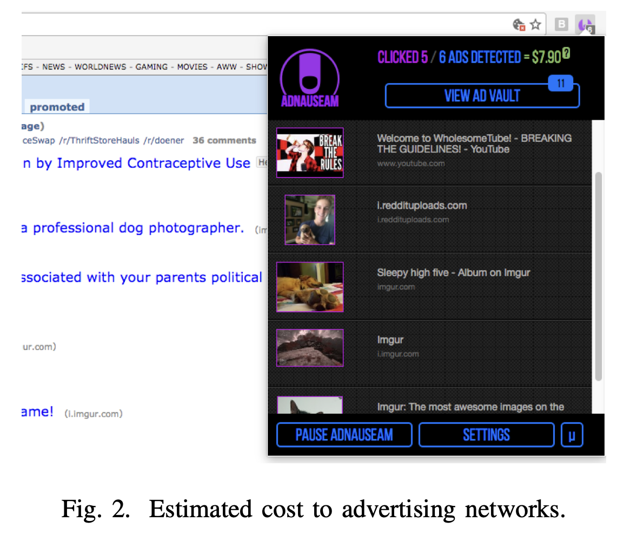
Data Union:
Data Protest:

Slide 20
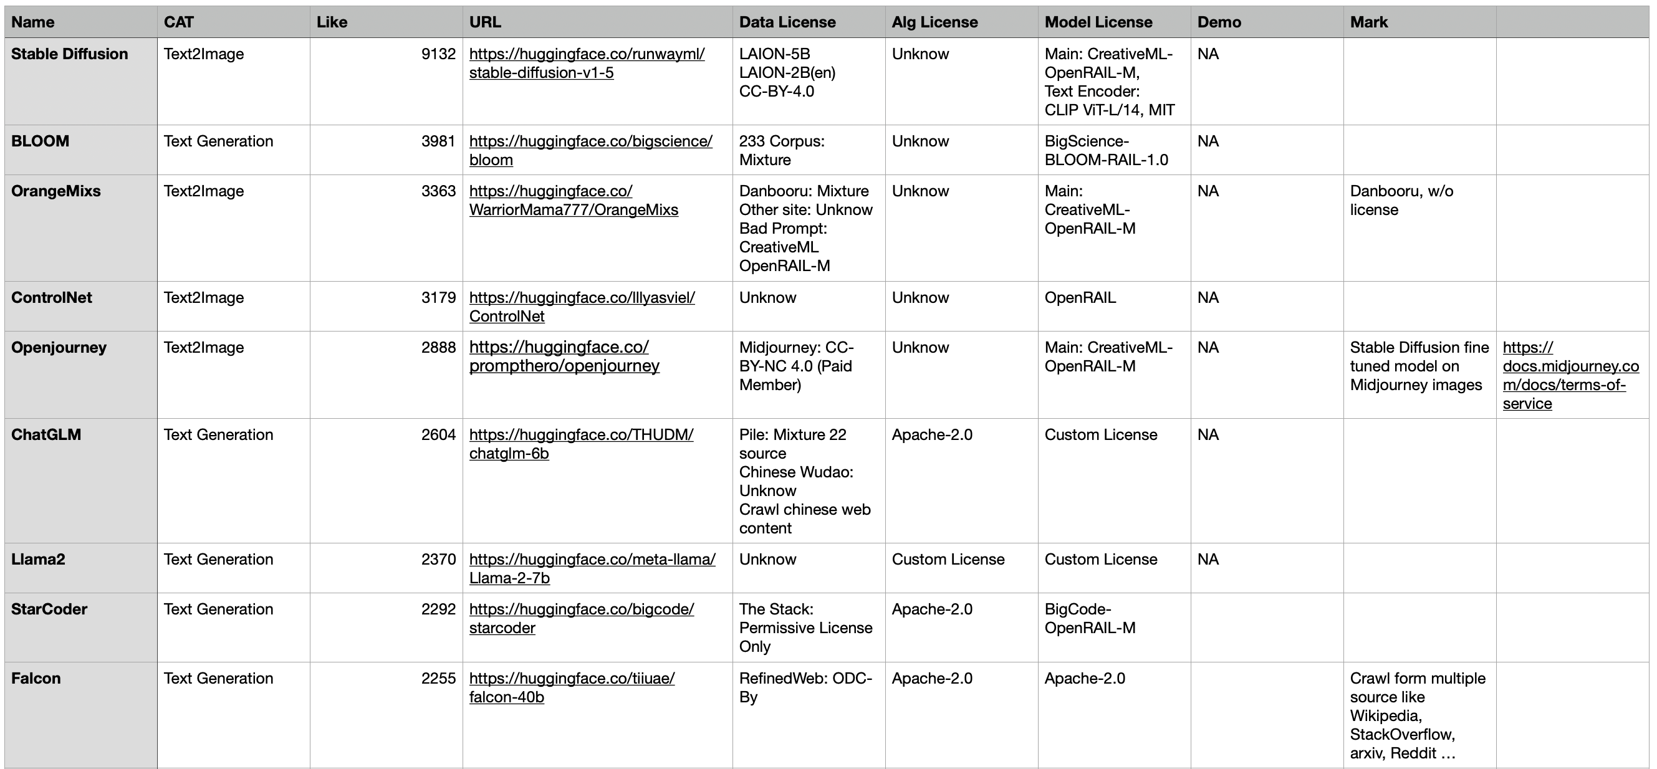
License stats for projects with more than 1K ❤️ on 🤗
 | Data License | Code License | Model License
all Permissive | 4 | 10 (OpenRAIL 1) | 14 (OpenRAIL 8)
risk of Copyleft | 10 | 0 | 0
Custom/Modified | 0 | 3 | 5
Unknow | 5 | 6 | 0
Mixture?

Slide 21
Regulations
App
Right Granting Assessment
Dataset
Software
Model
External License Conflicts:
Multiple Copyleft
Work
Work
Work
Copyright Infringement: License Identification, Provenance and Lineage
Work
Work
Work
Data Samples
Code
Sub-component

Slide 22
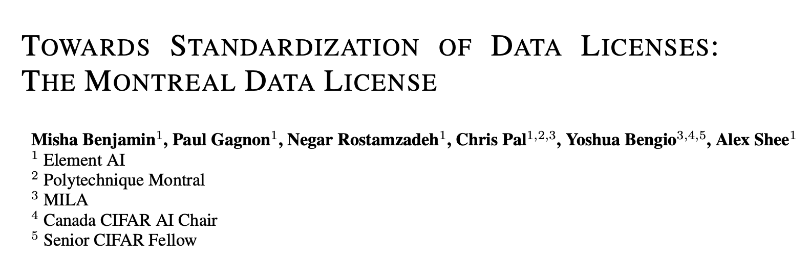
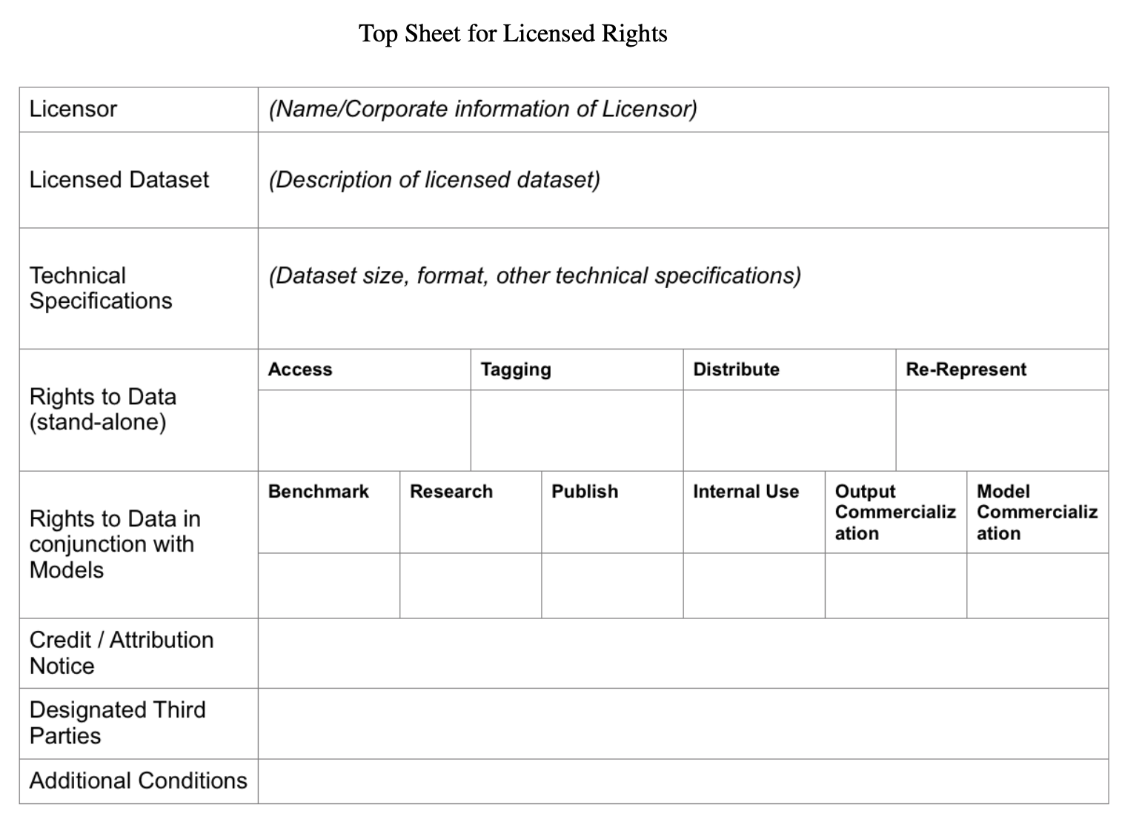
License Analysis for FOSS
Software Composition Analysis:
Scanning, Matching
License Exceptions
License Inconsistencies

Slide 23
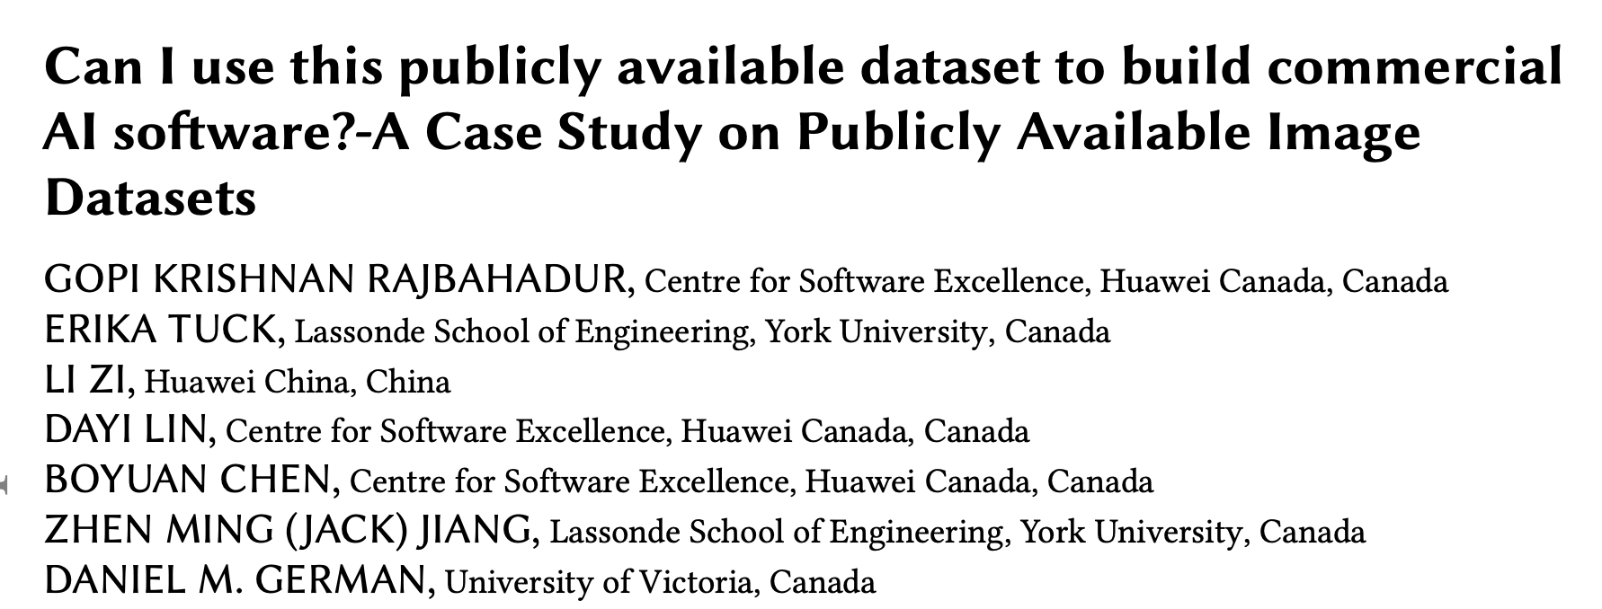
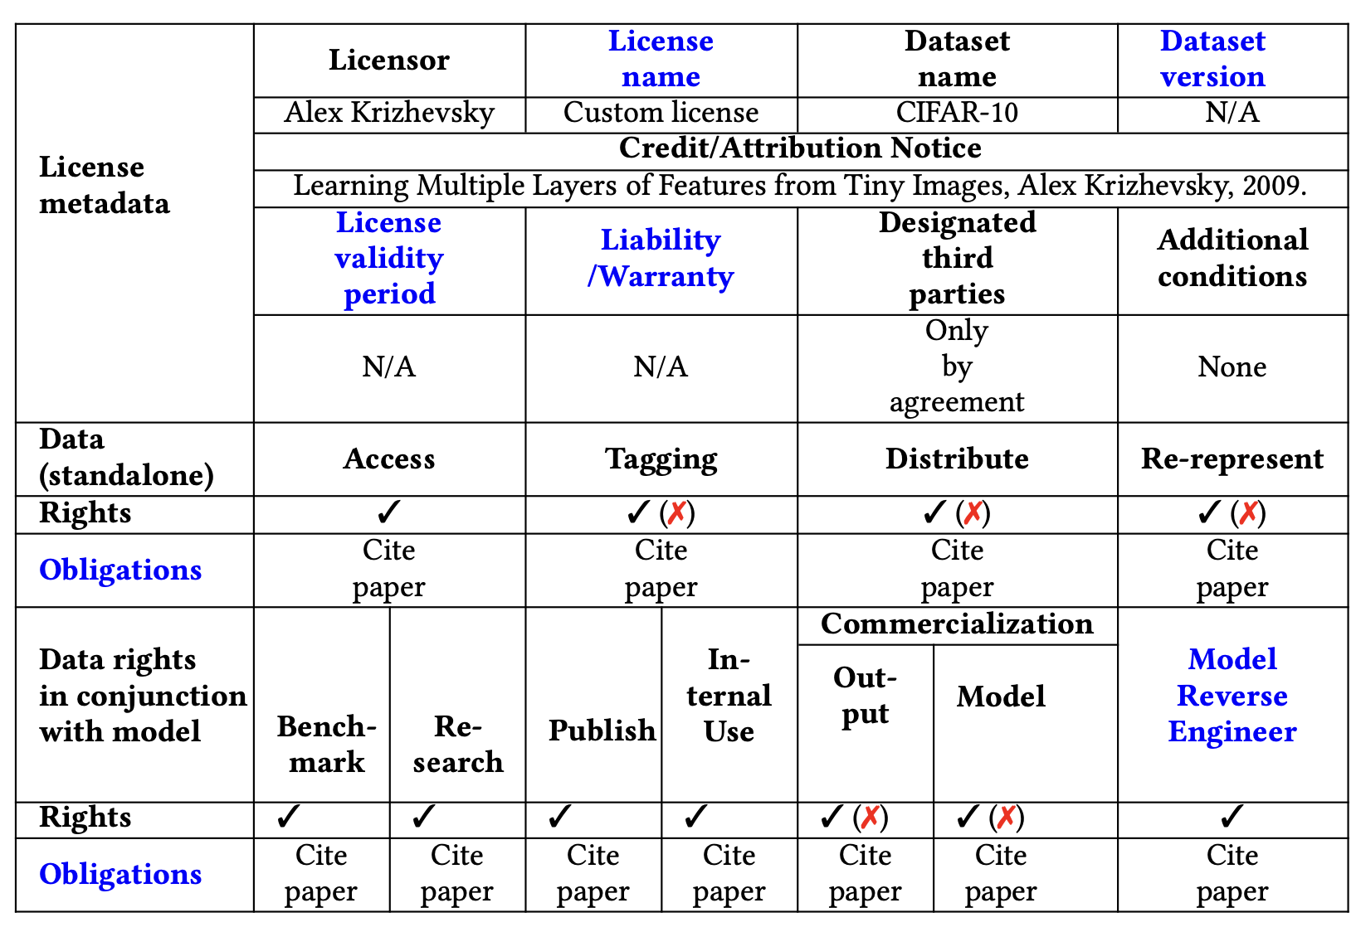
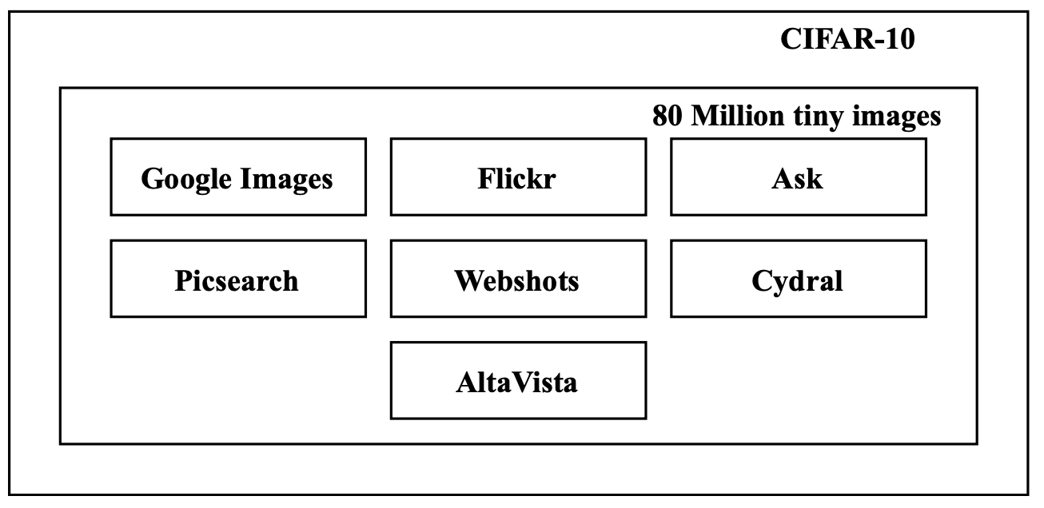

Slide 24
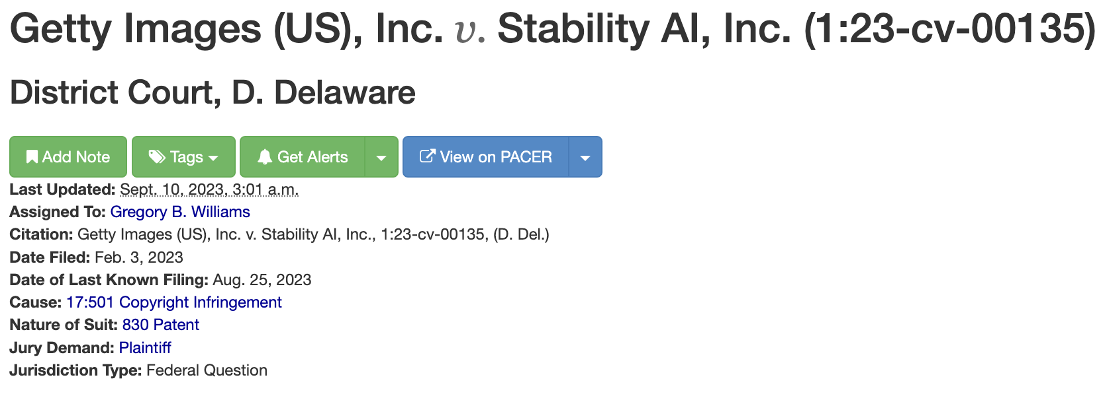
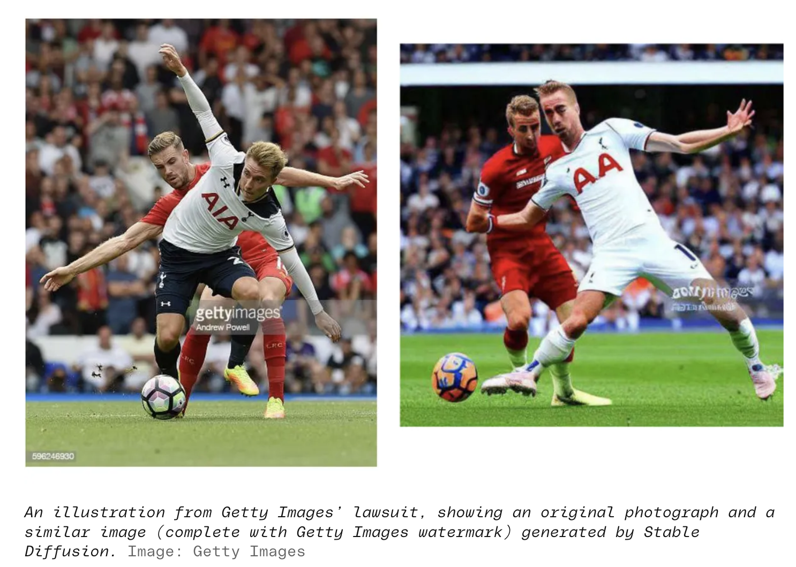
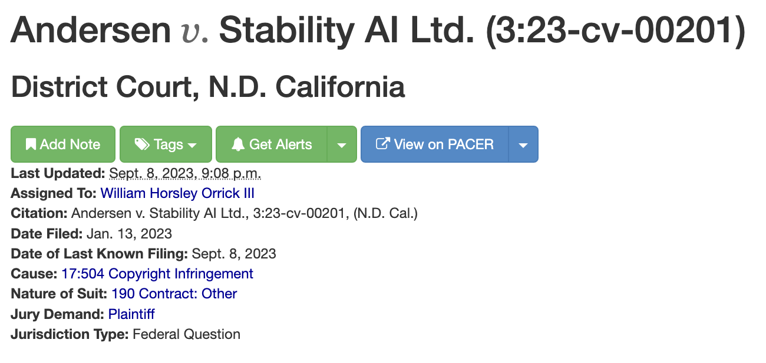
Copyright Infringement

Slide 25
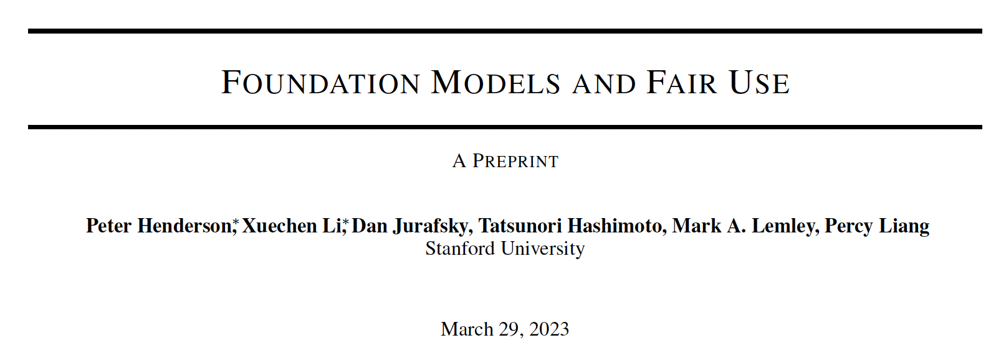
Legal
Technical
Copyrightable
Fair Use
License Analysis
Deep IP Protection
Whether machine-generated content can be copyrighted?
And who owns the copyright？
Photoshop, Word,
Generative Model…
Whether ML generated content can be considered Fair Use？
The legal doctrine of fair use provides some relief from liability for using copyrighted material without a license.
Whether the ML reuse process is legal compliant？
License Compatibility, Rights Granting, Redistribution, Commercial Use, Responsible Use.
How to protect NN models from plagiarism？
Watermark, Fingerprint, Authorization
In the realm of FL
Survey
ModelGo

Slide 26
Fair use defense is considering by
Transformativeness. [25%]
Predicting the similarity of two codes, Google Book, Recommendation Systems.
Nature of the copyrighted work. [5%]
Ideas, facts cannot be copyrighted.
Amount and Substantiality. [30%]
Quote, intermediate copying may not count against fair use.
Effect on Market. [40%]
Copies of books available to students on the school’s internal system.

Slide 27
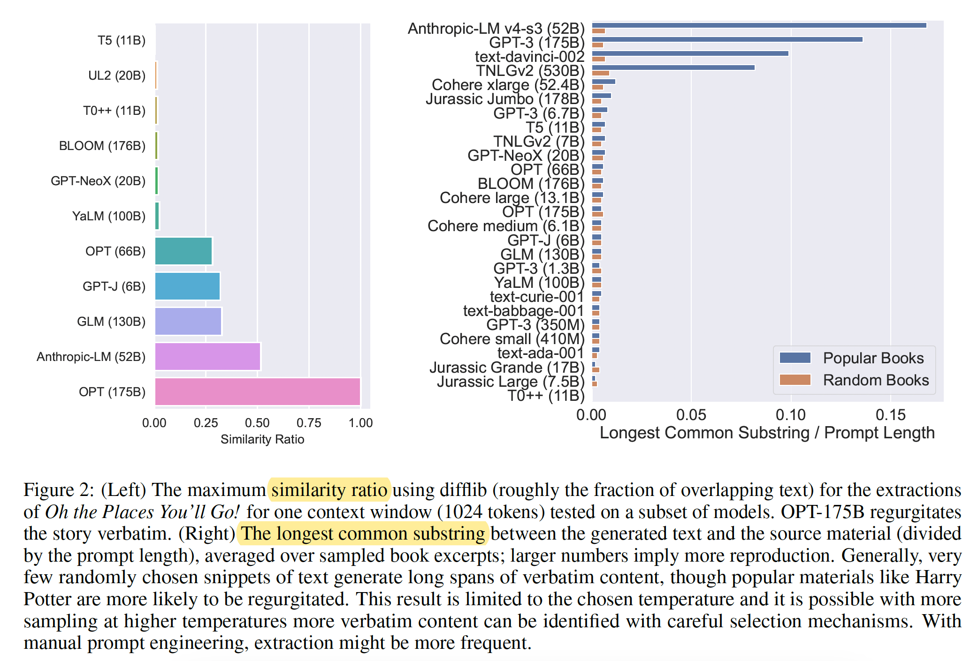
Natural Language Text
Research Topics:
1) Identify verbatim copying (the heart of work)
2) Identify insufficient transformations: translation, similar characters, …
3) Identify facts, parodies
> Hight Level Similarity Assessment

Slide 28
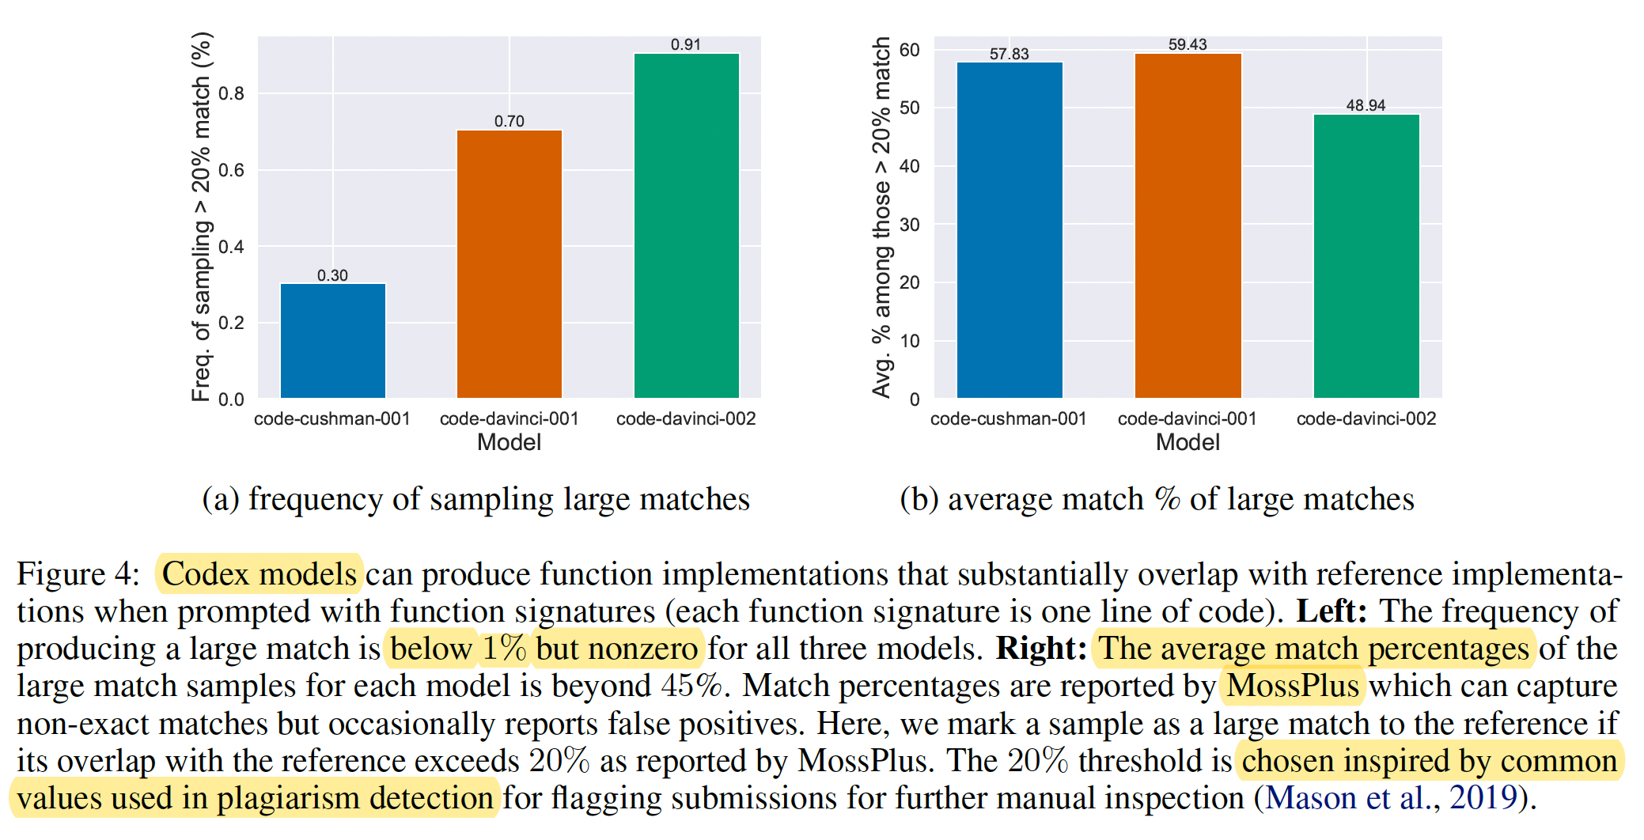
Code
Related Issues:
1) Reproducing Code Licensed Under GPL.
2) Transformation:
Inter-modular relationships, parameter lists, and macros.

Slide 29
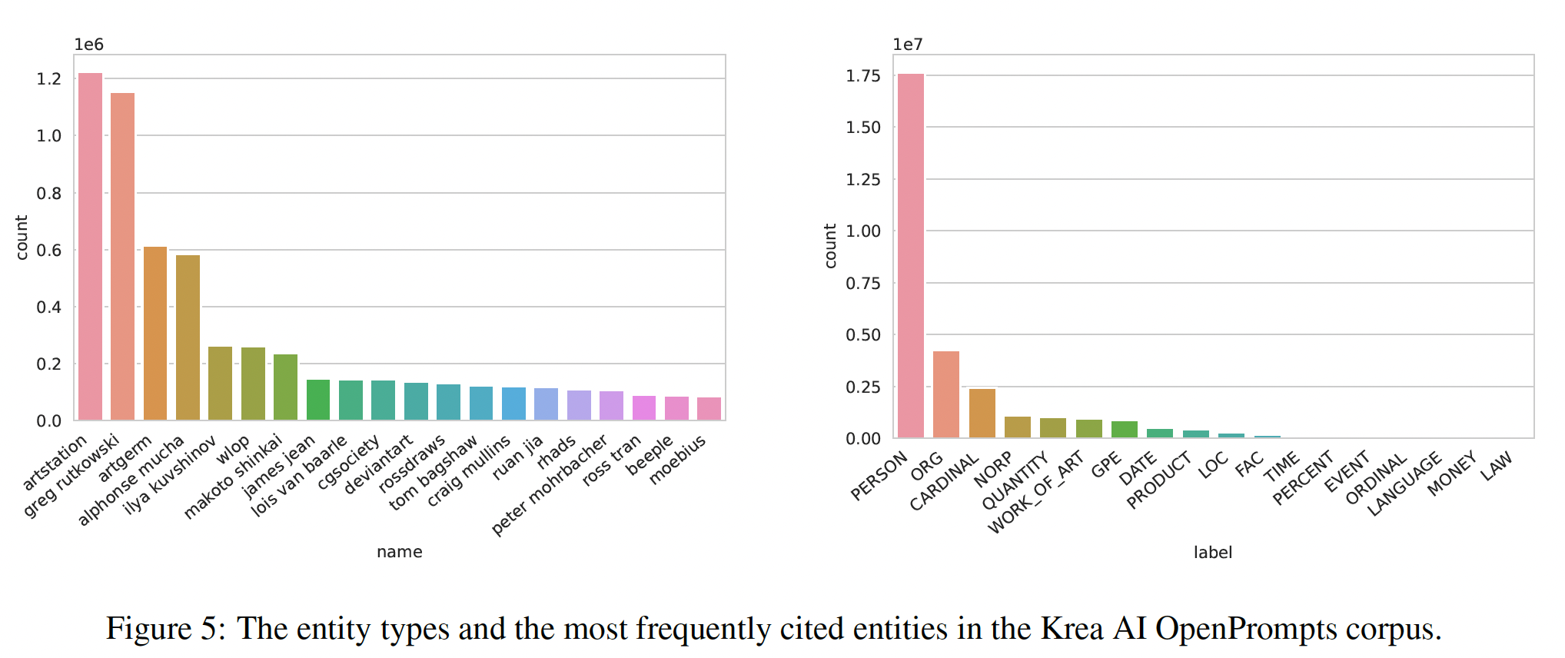
Image
Related Issues:
1) Transformation: Specific pattern, style, character.
2) Trademark. (e.g., Getty Image watermark, Micky Mouse)

Slide 30
Technical Mitigation
Data Filtering
Use only public domain, permissive-licensed, non-copyrightable content.
Remove duplicates for less memorization.
Output Filtering
Capture the fair use standards.
Instance Attribution
Determine the source of a generated output. (Shapley Values)
DP Training
In the context of mitigating copyright-related risk.
Learning from Human Feedback
Human feedback might reward verbatim generations of copyrighted content.

Slide 31
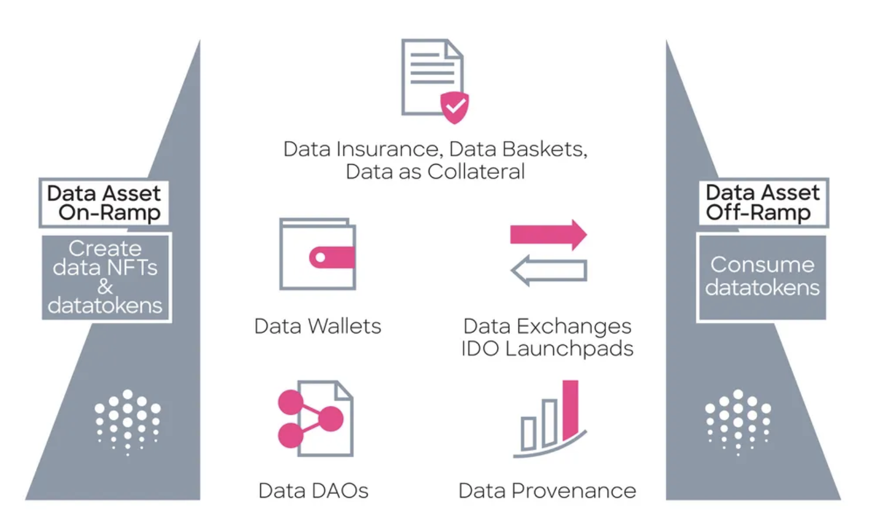
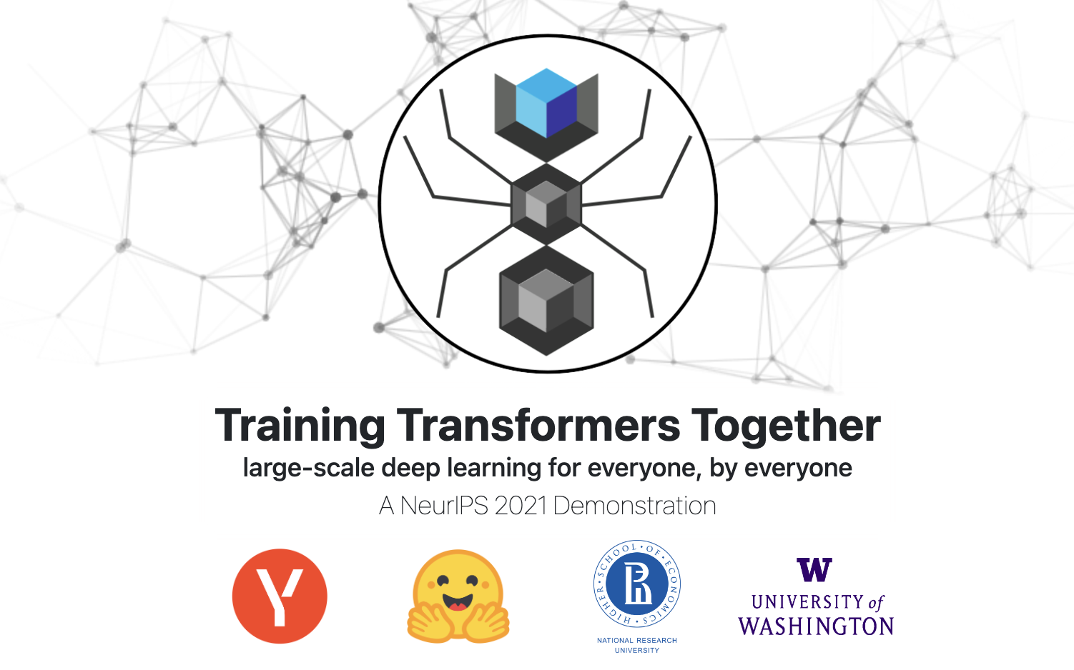
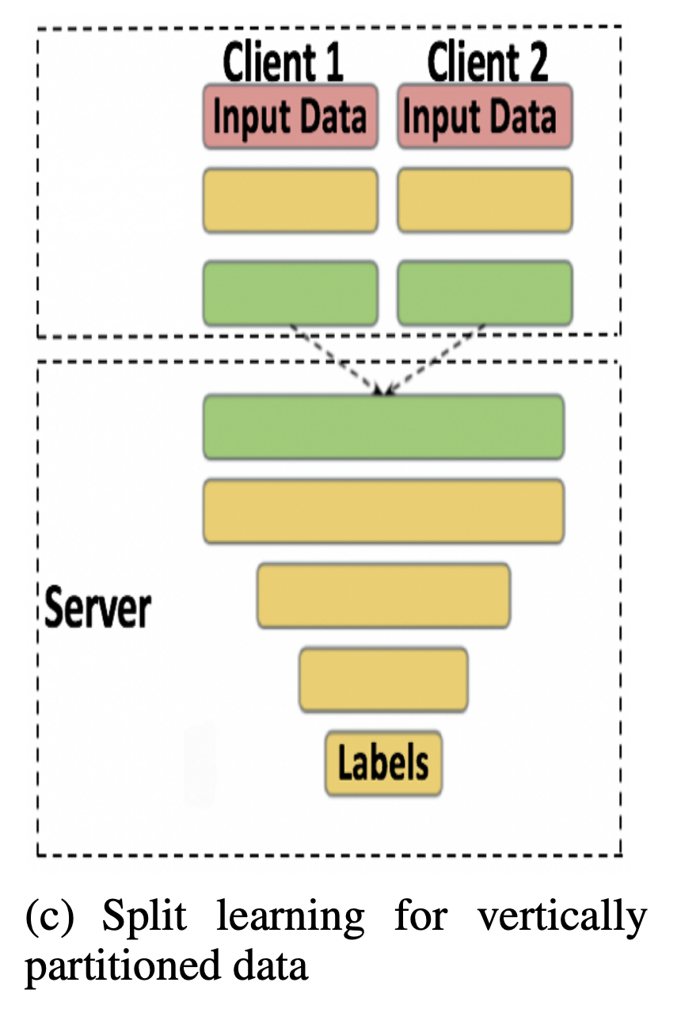
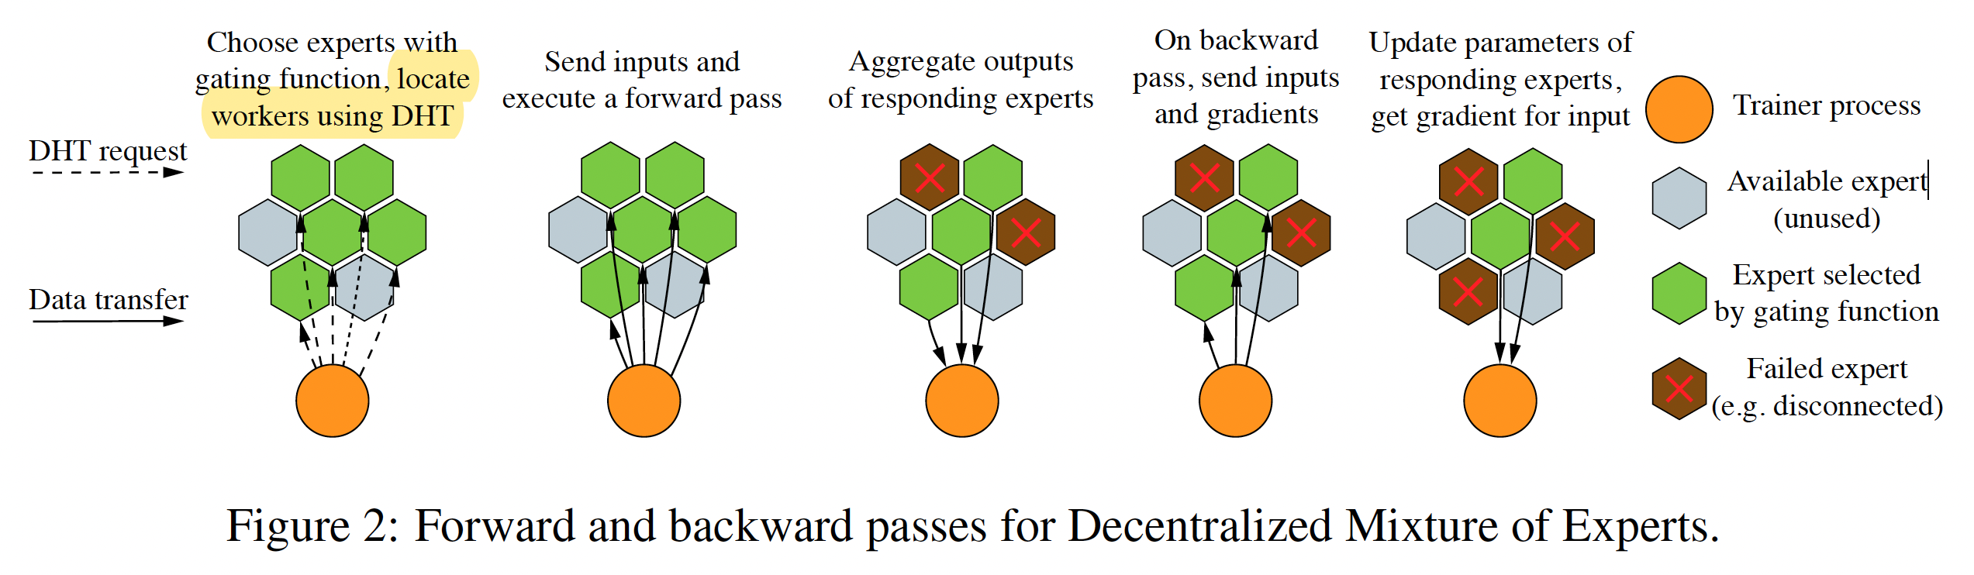
Volunteer Computing
Init Model + Open Dataset
Ocean Protocol
Init Model + Local Data + Datatokens
Collaborative ML
（Privacy-preserving）
Split Learning
Init Model + Local Vertical Data + ID-Label
Distributed MoE
Gating NN + Local Model +Val Data

Slide 32
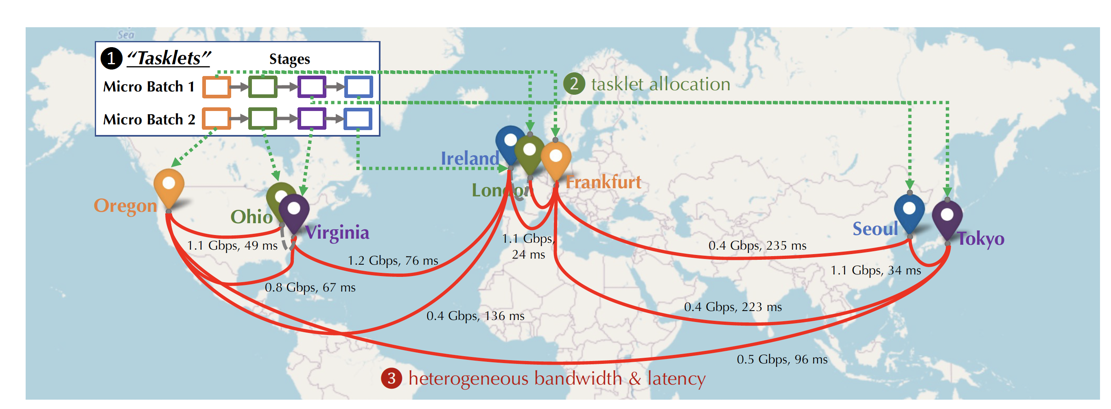
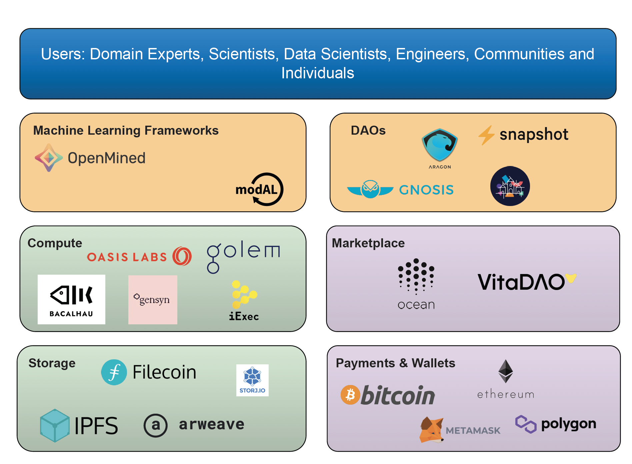

Distributed Training Network
Decentralized AI Hub
Crowdsourced Platform

Slide 33

Contract-based FL

Slide 34

How to Design ML Microtasks?
It depends on what resources the employers have and what tasks the workers can perform.

